Slide 1


West Virginia Consolidated Public Retirement Board
Employer Self Service (ESS) – OASIS Training

Slide 2
Today’s Agenda
Topic
Welcome and Introductions
Discussion Topics
Overview of COMPASS Overview of CPRB’s Employer Self Service (ESS) CPRB’s ESS Access Registering for ESS Logging into ESS Recover User ID Reset Password ESS Admin User Role & Functions Office Location Contact Person Type Assign User Roles Employer Certifications
Questions

Slide 3






Overview of COMPASS
Background
COMPASS:
  Provides fully integrated solution capable of supporting the WVCPRB vision:
    New pension system rich in browser based & web-enabled self service functionality, providing ease of use for:
      WVCPRB staff
      Members
      Retirees
      Beneficiaries
      Employers
  CPRB BlueZone
  Has been in use for over 4 decades
  Difficult and costly to maintain
  Does not provide robust web-based capability for self service to members
Benefits
Accessibility and member-oriented design
Improved efficiency and accuracy
The best service for members
Alignment with WVCPRB programs and policies
Innovation
with technology sustainable by WVCPRB
Why COMPASS?!?!
Notes:
Facilitator Notes:
The Deloitte Pension Administration Solution (DPAS), also known as COMPASS within WVCPRB, has been customized to provide a fully integrated solution capable of supporting WVCPRB vision of a new pension system. The system is rich in browser-based and web-enabled self service functionality, providing ease of use not only to WVCPRB users, but also to members, retirees, beneficiaries, and employers.
In the future, “Serving those who serve West Virginia” will be much easier.to the 21st Ce

Slide 4

Employer Self Service (ESS) Access
In order to Access CPRB’s Employer Self Service (ESS) portal, the employer contact person who will act as ESS Administrator will receive login credentials from CPRB.
Other employer staff members requiring access to CPRB’s ESS should contact their ESS Administrator for login credentials.
Notes:
Facilitator Notes:
ESS allows employers to submit employment classification and Contribution reports, process invoices using EFT accounts, manage users and perform other administrative tasks, view and verify CPRB IDs and generate key reports.

Slide 5
Registering for ESS
ESS Admin
Employer Reporting
Staff
WVCPRB staff will create necessary login credentials, including username, password, a temporary PIN for ESS Administrators.
Users will receive three separate emails – user name, password, and PIN.
Upon initially logging into ESS, Users are expected to change their password and select a security question. This completes their registration process.
The ESS Admin for your agency creates login credentials for other users.
These credentials include the username, password, and a temporary PIN.
Users will receive three separate emails – user name, password, and PIN
Users are required to log in, change password, and select a security question. This completes their registration process.
Notes:
Facilitator Notes:
For the first administrative user for each employer, CPRB staff will create a username and the system will then create the necessary login credentials, including a temporary PIN and password. The temporary PIN and password are valid for 72 hours after WVCPRB emails them. Administrative users will receive three emails, one with each piece of information they need to log into ESS – user ID, password, and PIN. When an employer’s ESS administrator logs into ESS for the first time, they are prompted to enter a new password and PIN and select a security question.
For other user types too, the CPRB staff creates login credentials, which includes a temporary PIN and password, and emails them to the new user. Similar to the administrative user, when a new user logs in to Self-Service, they are prompted to enter a new password and PIN and select a security question. The temporary PIN and password are valid for 72 hours after the administrative user emails them.
Users also have the options to change their password, PIN, and security question.
The ESS Administrative user will have the ability to request access to CPRB’s ESS portal for other staff members of the participating agency. If for some reason the agency’s ESS Administrative user does not have access, then the employer can contact CPRB to restore the ESS Administrative user’s access.

Slide 6
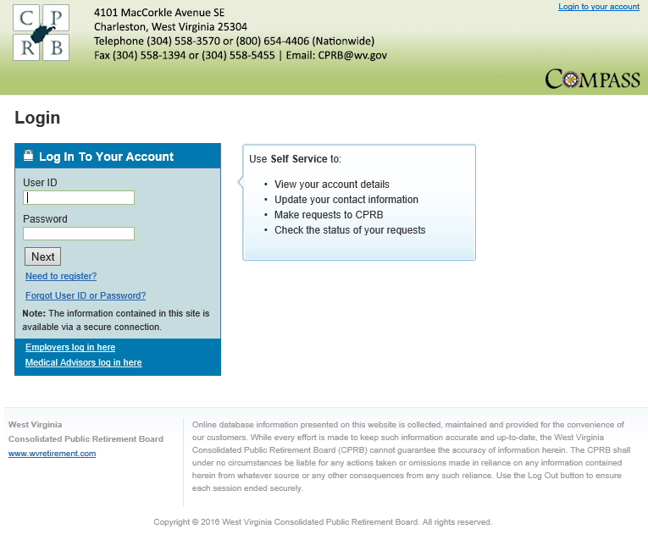
Demonstration – ESS Registration & Login
Let's now view the process to access ESS, Log into ESS, Recover Forgotten User ID and Reset Forgotten Password.
ESS Access
Registering for ESS
Logging into ESS
Recover User ID
Rest Password
Notes:
Facilitator Notes:
Perform a walk through of the steps mentioned in the ‘ESS Registration’ section of the Employer Self Service user guide.
Ensure that all participants are able to access their mailbox to retrieve all the three emails related to their username, password, and PIN.
In case, they cannot in the classroom set up, do let them know to have this registration process completed prior to attending the session. This will also include them selecting their preferred security question.
Then, on this slide, you are only logging into ESS (assuming everybody has already registered for the session).
Additionally, while you are on the log in page (as shown here), you might quickly show them options related to Forgot username, and Forgot password, and how the security question comes in handy then.

Slide 7
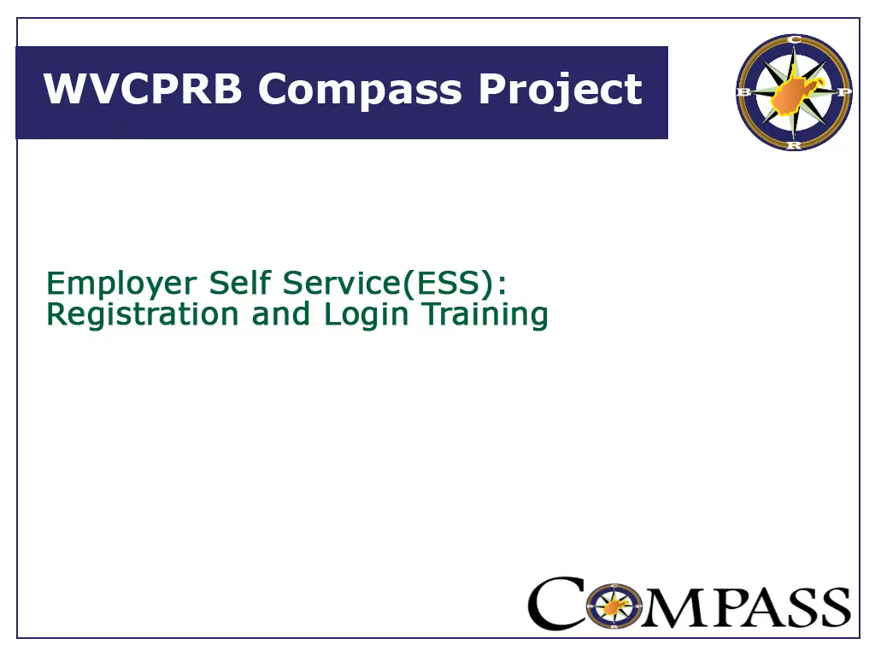

Slide 8

CPRB’s Employer Self Service User Roles
CPRB’s ESS User Roles provide user access to certain functionalities based on the assigned role. There are four ESS User Roles that can be assigned to employer staff members which are Administrator user (ESS Admin), Employer Reporting user, Staff user, and DSRS Fee Reporter.
Notes:
Facilitator Notes:
The Employer Self Service (ESS) web site allows employers to perform payroll reporting functions, user administrative functions and other member reporting functions. They key user administrative functions include: managing office locations, contact persons, and other ESS users.
The primary role is the ESS Administrator, the ESS Admin can manage office locations, contact person(s) and user accounts for their agency staff members

Slide 9
ESS Core Requirements
The following are functions exclusively allowed by the ESS Administrator and must be set-up prior to submitting an Employer Report:
Contact Persons
Manage Users
Office Locations
  View or update contact information for one of their employees who serves as a key contact for WVCPRB
  Add, remove, or edit ESS user accounts – including their role, passwords or even PIN.
  Add, edit, or delete office locations
Notes:
Facilitator Notes:
Manage Users functionality allows the employers, who have Admin access to add, remove, and edit ESS user accounts. Only employers with Admin access will see the menu option for Manage Users.
Administrators must associate contact information created using the Maintain Contact Person screen with a specific role - Admin, Reporting or Staff. Administrators will also have the ability to reset passwords and PINs and inactivate accounts.
Manage Office Locations allows employers to update (delete) their office locations through ESS. Only one Primary Location, Mailing Location and Third Party Location can be added per employer. Multiple office locations can be listed. An office location is then associated with a Contact Person account using the appropriate Contact Person module in ESS.
Employers must view or update contact information for one of their employees who serves as a key contact for WVCPRB. Contact persons added via the Maintain Employer module will be displayed to the employers through this module.
At least one contact person must be set as a Primary Contact. A unique email address must be assigned to each contact at the employer level. An office location must also be assigned to a contact person.

Slide 10
ESS User Roles Functions
Administrative User
  Has access to all ESS functionality including Manage Users
Employer Reporting User
  Has access to all ESS functionality except Manage Users
Staff User
  Has access to non-essential functions, such as Death Notice, Contact Persons, Maintain Seminars, Download CPRBs, and others
DSRS User
  Has access to be able to report DSRS fees only, no other access is given with this role assignment
Notes:
Facilitator Notes:
A ESS user role is of three types: ESS Administrator, Reporting, and Staff.
ESS Administrator – is powerful of all roles because it manage all other roles and assigns them rights.
ESS Reporting – is just one level below to ESS Administrator role. The role has access to most options, except Manage Users.
ESS Staff – the lowest in the rung of roles. These users can only perform few non-critical functions, such as Death Notice or Contact Persons, etc.
DSRS Fee Reporter: has access to be able to report DSRS fees only, no other access is given with this role assignment

Slide 11
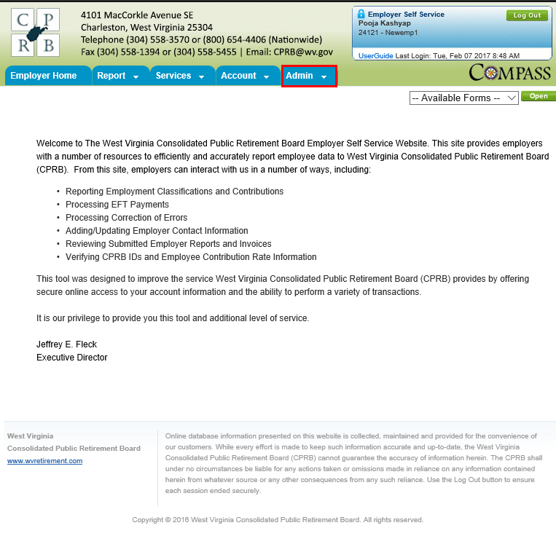
Demonstration – ESS Administrator Functions
Let’s view the functions the ESS Administrator can perform in ESS.
ESS Administration Functions
Office Locations
Contact Persons
Users
Notes:
Facilitator Notes:
Perform a walk through of the steps mentioned in the different sections of the Employer Self Service user guide.
Ensure all participants sitting through this module have the required ESS Administrator rights.
Ensure that contact persons are added via the Maintain Members module in COMPASS, so that they reflect in ESS.
Go over the three key ESS roles like in a quick quiz for participants will need to assign these roles in the Manage Users activity.

Slide 12
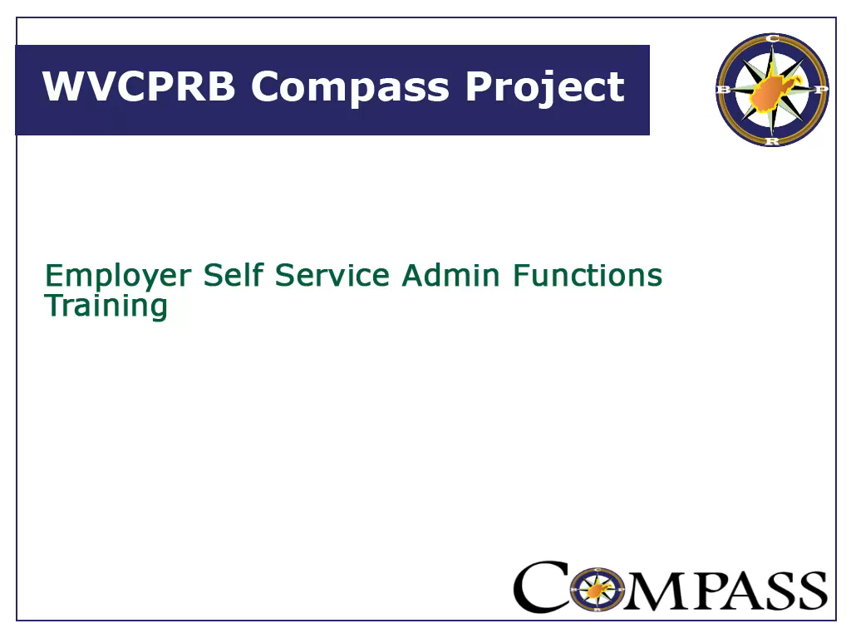

Slide 13
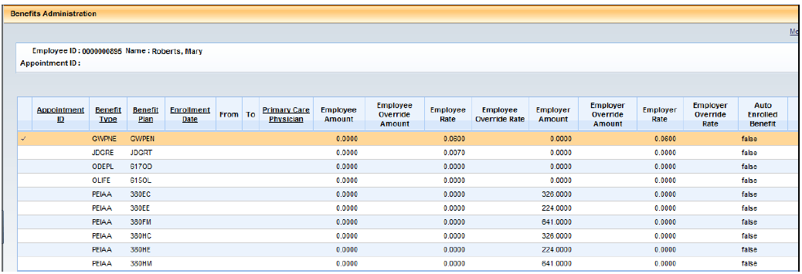
COMPASS: OASIS Reporting Employers
With OASIS as your system of record, you will continue to enroll your employees within the OASIS system as a function of paying your employees. In OASIS system locate the Benefits Administration activity folder:
Once the employee is located, click the Benefits Enrollment section of the BA page. The Benefits Enrollment page displays all of the benefits for which the employee is eligible including pensions:
The enrollment and contribution information that is reported to OASIS, such as your employee demographic data and earnings, will be passed on to CPRB from OASIS via a file sent through a secure transfer process.
When a report is submitted, it will be ‘balanced’ by CPRB and any discrepancies will be invoiced.

Slide 14
COMPASS: OASIS Reporting Employers
Any corrections that result in a difference between what was reported for an employee population in a particular reporting period and what was actually paid will be handled through the creation of invoices.
When corrections are required, you will need to make the needed updates in OASIS in order to remit the funds correctly to CPRB. See myApps→Enterprise Readiness→ Training→ HRM/Payroll and Supplemental Training Aids and Guides.
The payroll schedule for each plan year provided by OASIS will be updated automatically for all state agencies reporting via OASIS, and will not require the ESS Administrator for that agency to login to provide that information.

Slide 15
COMPASS: OASIS Reporting Employers
The COMPASS design teams have been working with the OASIS teams to integrate our two systems. OASIS and CPRB are working together to make the needed programming changes for the new COMPASS file layout.
The State of West Virginia is increasingly moving away from using sensitive data unless required, so you will have the option to use a permanent ID number, called the CPRB ID, instead of using an SSN.
A special screen is provided on the COMPASS Employer Self Service (ESS) portal for you to determine the correct contribution group prior to submitting contributions.

Slide 16

Download CPRB ID & Contribution Group Search
The Download CPRB ID screen provides the contribution group, CPRB ID, employee’s last name and last four digits of the employee’s SSN for a particular employee or a set of employees.
The Contribution Group Search is used to “organize” employees into different contribution rate categories and to validate their contribution amounts.
Notes:
Facilitator Notes:

Slide 17
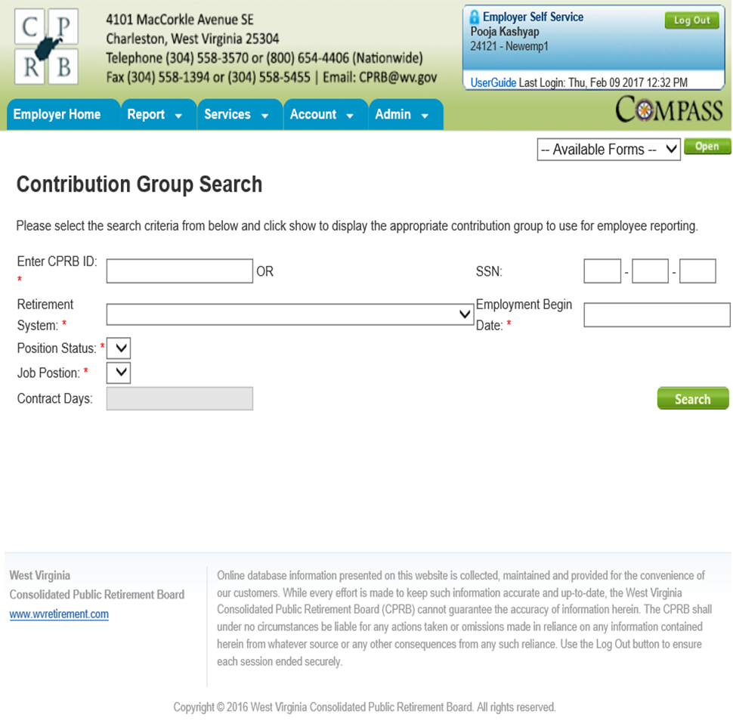
Contribution Group Search

Slide 18

Employer Certifications
ESS allows employers to certify employee requests
for retirement, refund, disability, or service purchase. A certification email notification is sent to the employer informing them that an employee or former employee has initiated a request or a CPRB staff member initiated a request in COMPASS.
Notes:
Facilitator Notes:
ESS allows employers to certify employee requests through the self service module instead of filling out and signing paper forms. A certification will only appear when an employee or former employee has initiated a request with WVCPRB for a retirement, refund, disability or a service purchase.
On the Certification screen, only certifications in pending status display. Administrative and employer reporting users can use the Certification screen to approve or reject these certifications.

Slide 19
Types of Certifications
An Employer Self Service Administrator can view and approve the following certification types for their department(s):
Retirement
Retirement request are initiated by a member (either via Member Self Service or submitting application to CPRB)
Employers certify the application and CPRB complete the retirement process for the member
Refunds
Refund request can be submitted by a member on Member Self Service or through COMPASS; if additional information or approval is required then the Employer will certify the Refund request through ESS
Service Purchase
Service purchase request are initiated by a member
Sent to the Employer for certification by CPRB as to process the members request
Disability
Disability request are initiated through Member Self Service or through COMPASS; if additional information or approval is required then the Employer will certify the Disability request through ESS
Notes:
Facilitator Notes:
Service Purchase requests are initiated by a service purchase counselor by providing comments and clicking on ‘Return to ESS’ button from COMPASS. These requests appear on ESS and require additional information from the employer to process the service purchase request. Once additional information has been added by the employer, the certification is submitted. Consequently the service purchase request status is updated to ‘Progress’ and workflow process service purchase resumes and is placed in the service purchase queue. Internal WVCPRB users next process the request using COMPASS’s Service Purchase module.
Retirement requests are initiated either by the member using Member Self Service or by the traditional retirement form. Request information will be created upon electronic submission of the retirement application via Member Self Service. If a paper form is received then an internal WVCPRB user will use retirement application form to create Request. On submission of Request. The application must be approved by the employer. Once the employer approves the application, the status of the Term Date (Employment End Date) Verification and Final Salary verification will be updated.
Refund and Disability requests are initiated through Member Profile. These requests appear on ESS and require additional detail from the employer. Once additional details have been added by the employer, the certification is submitted.

Slide 20
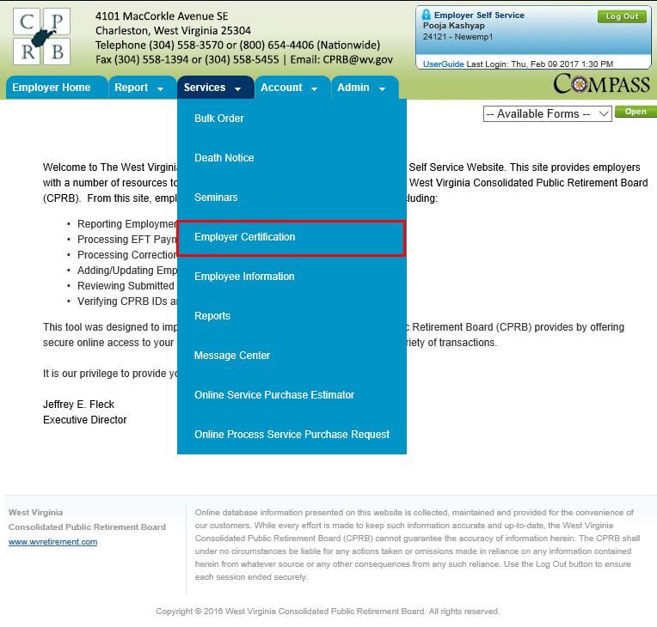
Demonstration – Employer Certifications
Let’s view the certification options in ESS
Retirement & Refunds Certifications
Certify a Retirement
Certify a Refund
Notes:
Facilitator Notes:
Perform a walk through of the steps mentioned in the ‘ESS Registration’ section of the Employer Self Service user guide.
Ensure that all participants are able to access their mailbox to retrieve all the three emails related to their username, password, and PIN.
In case, they cannot in the classroom set up, do let them know to have this registration process completed prior to attending the session. This will also include them selecting their preferred security question.
Then, on this slide, you are only logging into ESS (assuming everybody has already registered for the session).
Additionally, while you are on the log in page (as shown here), you might quickly show them options related to Forgot username, and Forgot password, and how the security question comes in handy then.

Slide 21
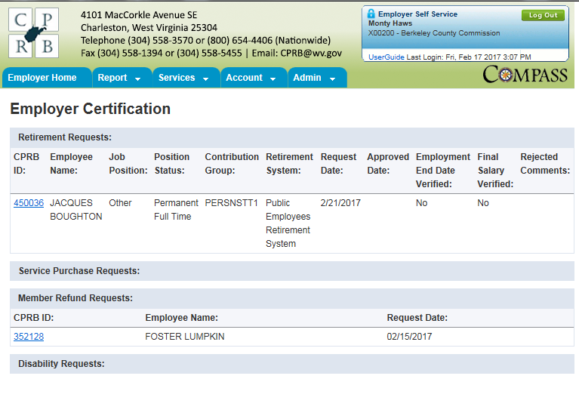
Certifications Waiting for Completion

Slide 22
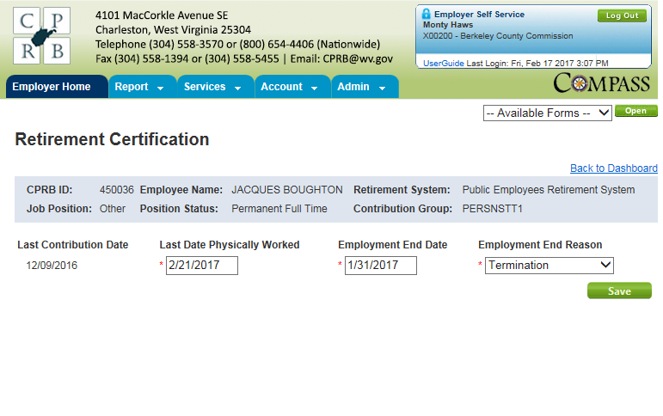

Retirement Certification – Before Save

Slide 23
wvOASIS Date Locations
Last Date Physically Worked: Is the “From” date of the ESMT “TRSN” or “TRSNF” document.
This is located on the EPM (Employee Profile Management) activity folder:
Locate the applicable employee and review their complete timeline – highlight the line with the Personnel Action of TRSN or TRSNF.
Exceptions are for death or disability retirement it is the last day paid. If they left while on Workers comp, it is the last day the employee was paid TTD benefits.
Employment End Date: Is the same as the above date, the same as the Last Date Physically Worked, unless there is an exception such as death, disability or workers’ comp.

Slide 24
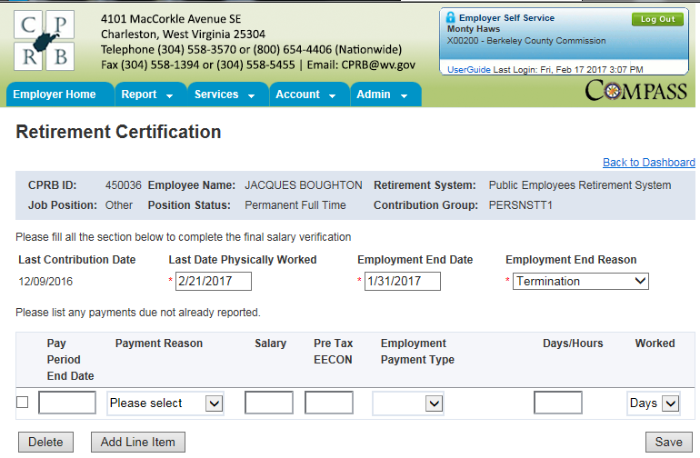

Retirement Certification – After Save
Payment Reason
= Pay Event in wvOASIS i.e.
Regular Increment Annual Payout (non-pensionable) Compensatory Bank Holiday, etc.
PERS1 – 4.5%
PERS2 – 6.0%
E = Elected Paid Current (Per Diem)
S = Salary
H = Hourly
Days =
Salary
Hours =
Hourly (35, 37.5 or 40.0

Slide 25
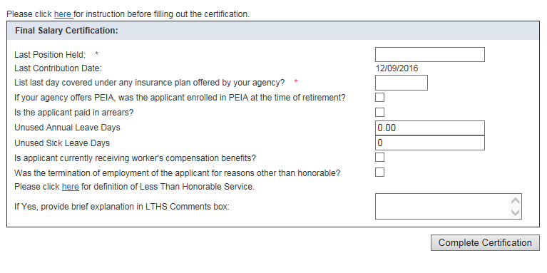


Retirement Certification – Final
Check the box if they were
All employees paid in arrears except Elected Paid Current - EPC

Slide 26
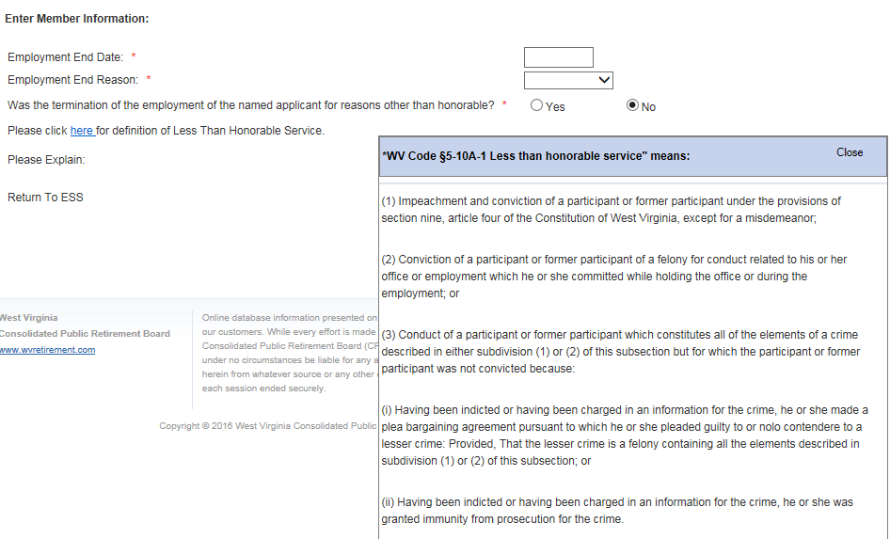
LTHS Definition

Slide 27
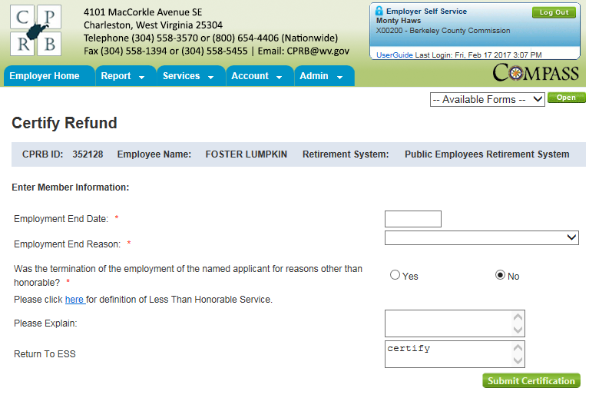
Refund Certification

Slide 28
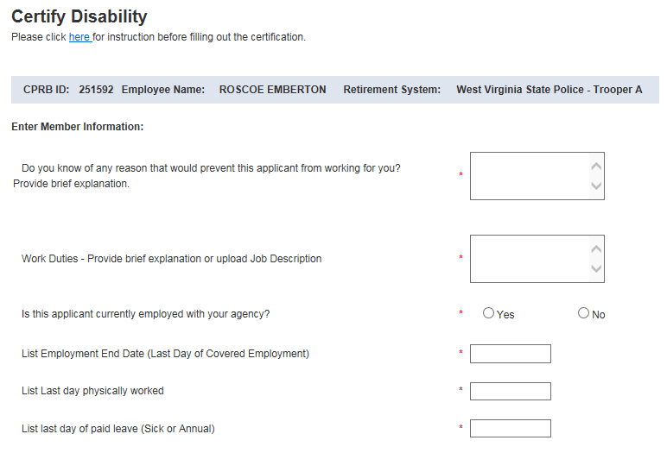
Disability Certification – Part 1

Slide 29
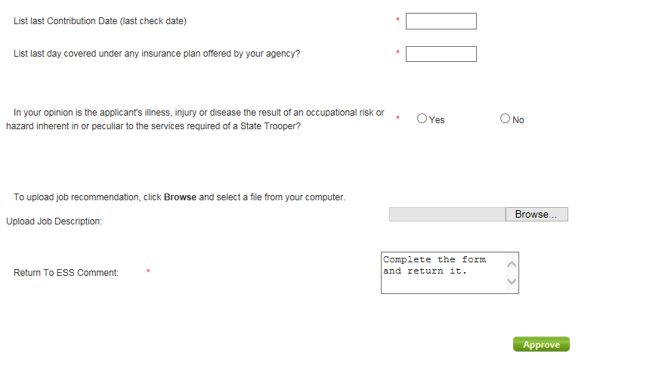
Disability Certification – Part 2

Slide 30
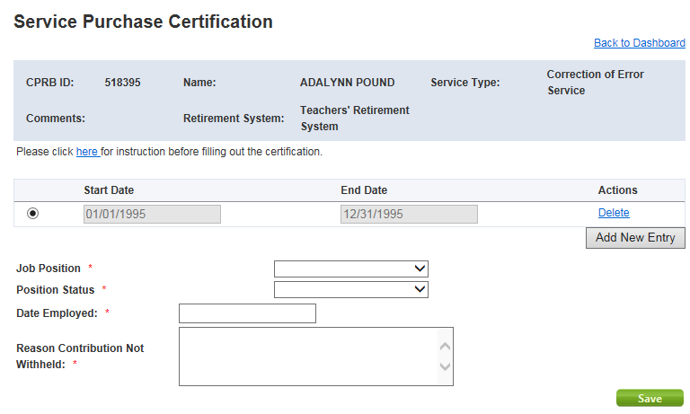
Service Purchase Certification – CES Part 1

Slide 31
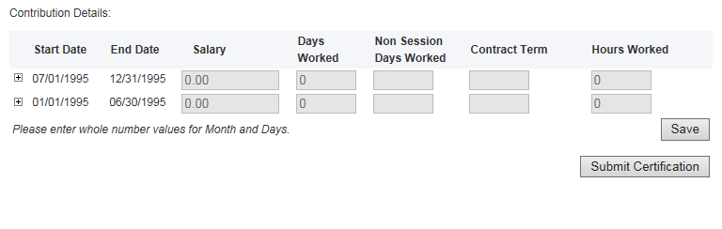
Service Purchase Certification – CES Part 2

Slide 32
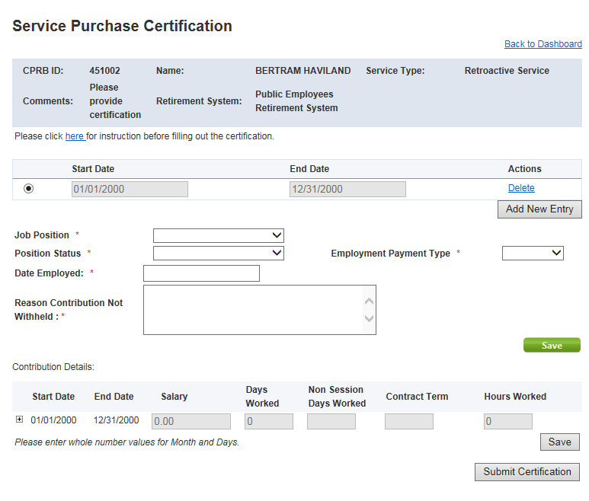
Service Purchase Certification – Retro

Slide 33

Email Us:
CPRBEmployerHelp@wv.gov
Phone: 304-558-1395 or 855-867-3797

Slide 34

wvOASIS Contact Us!
For CPU Payroll Questions contact: CPU_HRMPAYROLL@wvOASIS.gov
For Enterprise Readiness Questions contact: EnterpriseReadiness@wvOASIS.gov
For Help Desk Questions contact:
Helpdesk@wvOASIS.gov
For Interface Questions contact:
Interfaces@wvOASIS.gov
For Kronos Questions contact:
Kronos@wvOASIS.gov
For Report Questions contact:
Reports@wvOASIS.gov
For Security Questions contact:
Security@wvOASIS.gov
For Training Questions contact:
Training@wvOASIS.gov
Website: wvOASIS.gov
34

Slide 35

West Virginia
COMPASS
Wild, Wonderful

