Slide 1


West Virginia Consolidated Public Retirement Board
Employer Self Service (ESS) – WVEIS Training

Slide 2
Today’s Agenda
Topic
Welcome and Introductions
Discussion Topics
Overview of CPRB’s Employer Self Service (ESS) CPRB’s ESS Access ESS Admin User Role & Functions Submit Payroll Schedule Process Employer Reports Submit Employment Classification & Contribution – File Upload Error Correction Invoicing Employer Certifications
Questions

Slide 3






Overview of COMPASS
Background
COMPASS:
  Provides fully integrated solution capable of supporting the WVCPRB vision:
    New pension system rich in browser based & web-enabled self service functionality, providing ease of use for:
      WVCPRB staff
      Members
      Retirees
      Beneficiaries
      Employers
  CPRB BlueZone
  Has been in use for over 4 decades
  Difficult and costly to maintain
  Does not provide robust web-based capability for self service to members
Benefits
Accessibility and member-oriented design
Improved efficiency and accuracy
The best service for members
Alignment with WVCPRB programs and policies
Innovation
with technology sustainable by WVCPRB
Why COMPASS?!?!
Notes:
Facilitator Notes:
The Deloitte Pension Administration Solution (DPAS), also known as COMPASS within WVCPRB, has been customized to provide a fully integrated solution capable of supporting WVCPRB vision of a new pension system. The system is rich in browser-based and web-enabled self service functionality, providing ease of use not only to WVCPRB users, but also to members, retirees, beneficiaries, and employers.
In the future, “Serving those who serve West Virginia” will be much easier.to the 21st Ce

Slide 4

Employer Self Service (ESS) Access
In order to Access CPRB’s Employer Self Service (ESS) portal, the employer contact person who will act as ESS Administrator will receive login credentials from CPRB.
Other employer staff members requiring access to CPRB’s ESS should contact their ESS Administrator for login credentials.
Notes:
Facilitator Notes:
ESS allows employers to submit employment classification and Contribution reports, process invoices using EFT accounts, manage users and perform other administrative tasks, view and verify CPRB IDs and generate key reports.

Slide 5
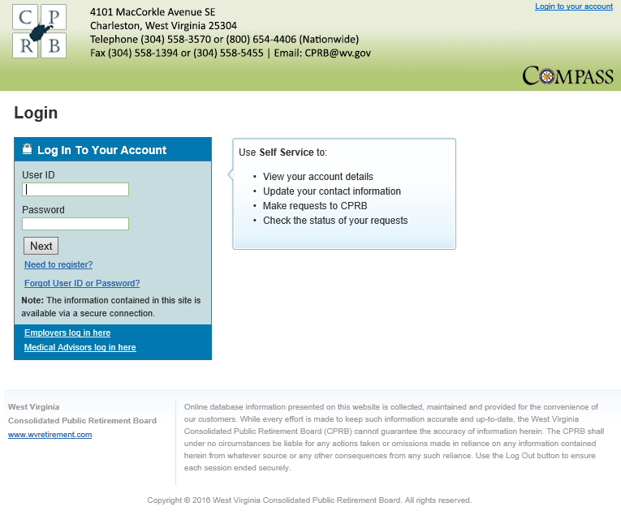
ESS Registration & Login
To access ESS, Log into ESS, Recover Forgotten User ID and Reset Forgotten Password.
ESS Access
Registering for ESS
Logging into ESS
Recover User ID
Rest Password
Notes:
Facilitator Notes:
Perform a walk through of the steps mentioned in the ‘ESS Registration’ section of the Employer Self Service user guide.
Ensure that all participants are able to access their mailbox to retrieve all the three emails related to their username, password, and PIN.
In case, they cannot in the classroom set up, do let them know to have this registration process completed prior to attending the session. This will also include them selecting their preferred security question.
Then, on this slide, you are only logging into ESS (assuming everybody has already registered for the session).
Additionally, while you are on the log in page (as shown here), you might quickly show them options related to Forgot username, and Forgot password, and how the security question comes in handy then.

Slide 6

CPRB’s Employer Self Service User Roles
CPRB’s ESS User Roles provide user access to certain functionalities based on the assigned role.
There are four ESS User Roles that can be assigned to employer staff members which are Administrator (ESS Admin), Employer Reporting, and Staff, these will be used by the BOEs. There is also a Fee Coordinator role which is for DSRS Fees and County Commissions.
Notes:
Facilitator Notes:
The Employer Self Service (ESS) web site allows employers to perform payroll reporting functions, user administrative functions and other member reporting functions. They key user administrative functions include: managing office locations, contact persons, and other ESS users.
The primary role is the ESS Administrator, the ESS Admin can manage office locations, contact person(s) and user accounts for their agency staff members

Slide 7
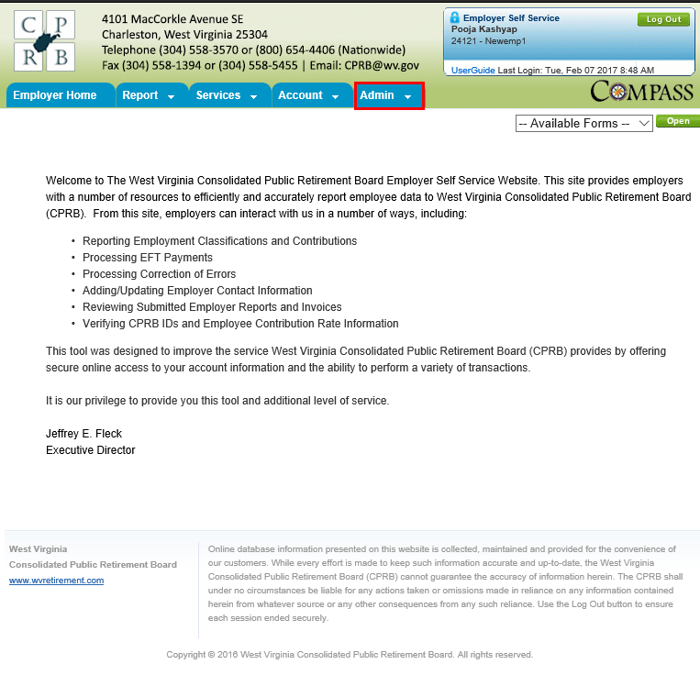
ESS Administrator Functions
Functions the ESS Administrator can perform in ESS.
ESS Administration Functions
Office Locations
Contact Persons
Users
Notes:
Facilitator Notes:
Perform a walk through of the steps mentioned in the different sections of the Employer Self Service user guide.
Ensure all participants sitting through this module have the required ESS Administrator rights.
Ensure that contact persons are added via the Maintain Members module in COMPASS, so that they reflect in ESS.
Go over the three key ESS roles like in a quick quiz for participants will need to assign these roles in the Manage Users activity.

Slide 8

Payroll Schedule
The Payroll Schedule is critical information that must be reported annually to CPRB in order to submit contribution reports and payments for the upcoming year in a timely manner.
Notes:
Facilitator Notes:
All invoices that are generated by a batch process (or manually) in COMPASS appear on the Invoices page. Additionally, employers have the option of remitting payment for invoices as part of the Monthly Report submission process. Each invoice will be viewable in PDF form and the employers stored EFT or e-Check payment account information can be used to remit payment for the invoices.
Note: The most recent unpaid invoices display on the screen. Invoices with a status of Cancel or Write Off do not display here. Credit invoices also do not display on the Invoices page.

Slide 9
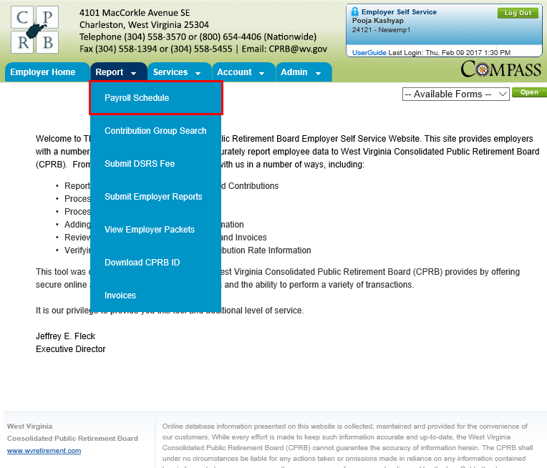
Demonstration – Manage Payroll Schedule
Let's now view the steps to add and view a payroll schedule.
Payroll Schedule
Add Payroll Schedule
View Payroll Schedule
Notes:
Facilitator Notes:
Perform a walk through of the steps mentioned in the different sections of the Employer Self Service user guide.
Ensure all participants sitting through this module have the required ESS Administrator rights.
Ensure that contact persons are added via the Maintain Members module in COMPASS, so that they reflect in ESS.
Go over the three key ESS roles like in a quick quiz for participants will need to assign these roles in the Manage Users activity.

Slide 10
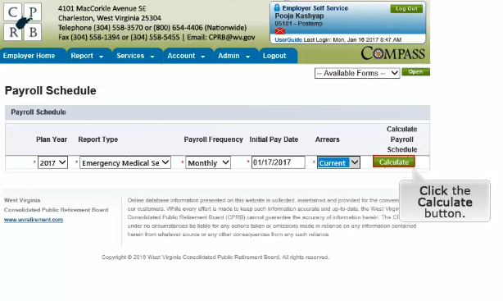
Calculating the Payroll Schedule

Slide 11
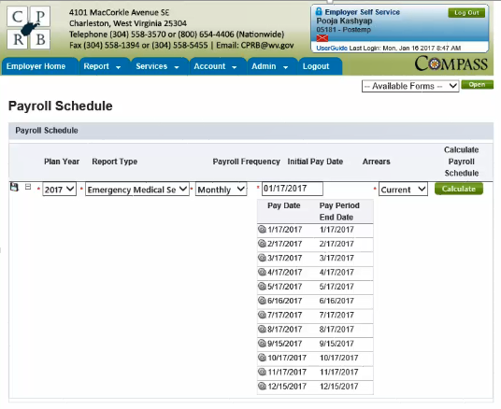
Adjusting the Projected Payroll Schedule

Slide 12
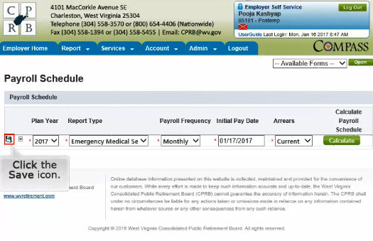
Saving the Payroll Schedule

Slide 13
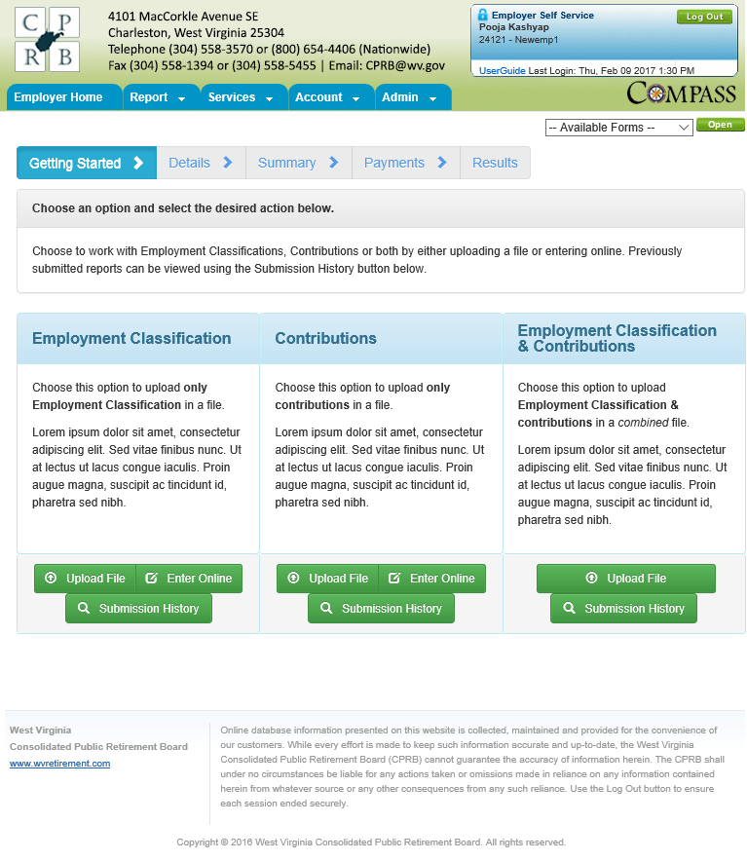
Employment Classification & Contribution
Processing Employment Classification & Contribution Report
Submit Employment Classification & Contribution
Notes:
Facilitator Notes:
Perform a walkthrough of the steps mentioned in the Submit Employer Reports section in the Employer Self Service user guide.
Additionally, ensure the following for participants to perform the Try Me:
Ensure each participant has their ESS user account set up with the required privileges, ability to upload employer employment classification and contributions in this case.
Ensure each participant as a file one each for employment classification, Contribution, and employment classifications and Contribution activities. If time is a constraint, you might keep the last activity only as that covers both employer reports.
Also insist participants to use the Enter-Online method (in addition to Upload File option) to upload all require information into the system for WVCPRB to consider.

Slide 14
COMPASS Employer Self Service Portal:
WVEIS Reporting Employers
With WVEIS as your reporting method, you will continue to enroll your employees within the WVEIS system as a function of paying your employees.
The enrollment and contribution information that is reported to WVEIS, such as your employee demographic data and earnings, will be passed on to CPRB via a file sent through a secure transfer process.
The file will be uploaded into COMPASS and you will be able to see reports regarding the information CPRB received from WVEIS, this can be accessed through the Submit History button under the combined employment classification and contribution option.

Slide 15
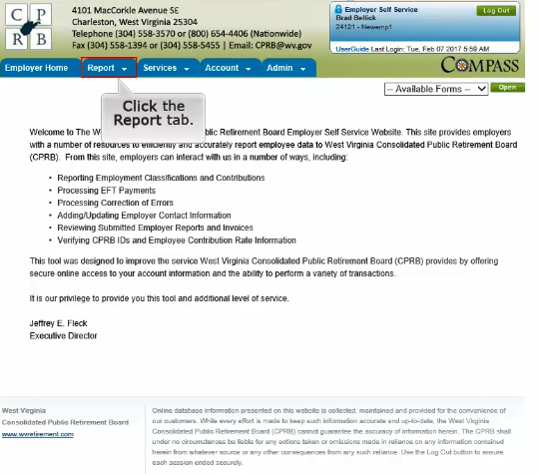
Submit Employer Report

Slide 16
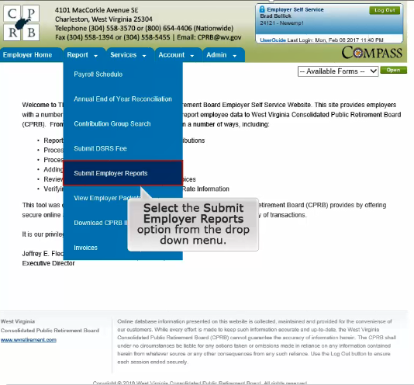
Submit Employer Report

Slide 17
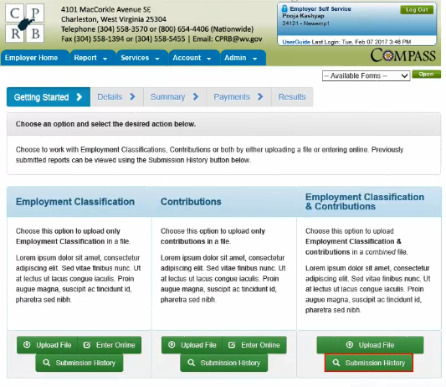
Getting Started

Slide 18
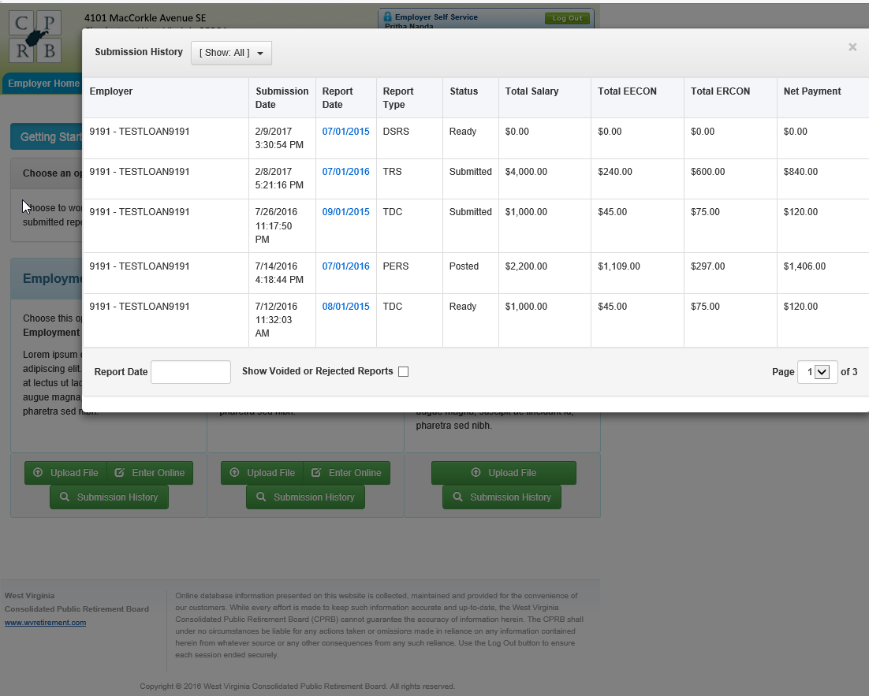
Submission History

Slide 19
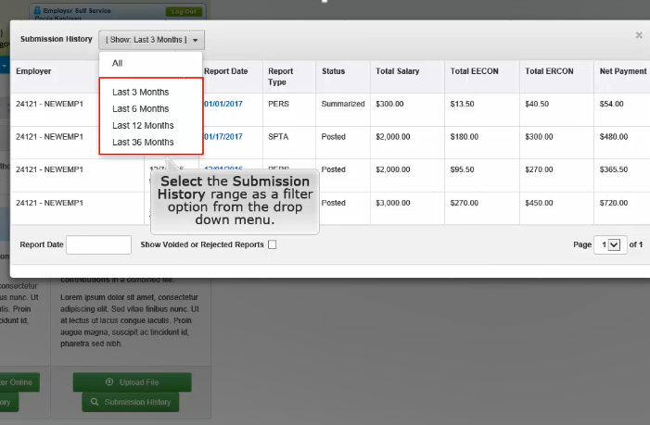
Submission History – Search by Date Range

Slide 20
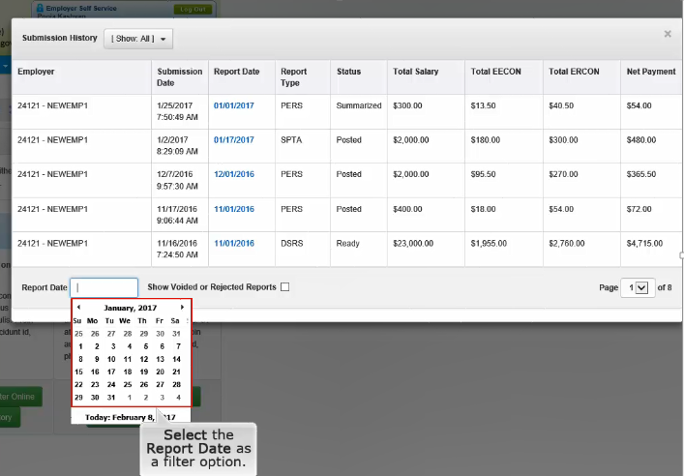
Submission History – Search by Report Date

Slide 21
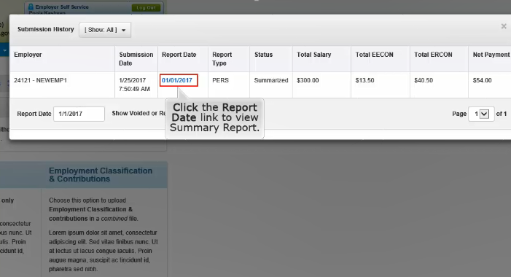
Submission History – Selecting a Report

Slide 22
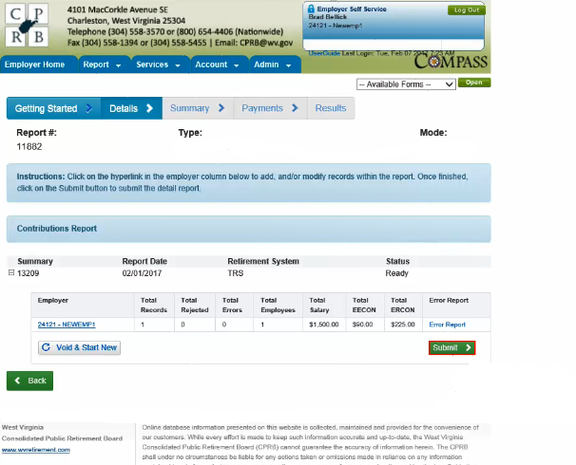
Adjusting Prior to Submitting

Slide 23
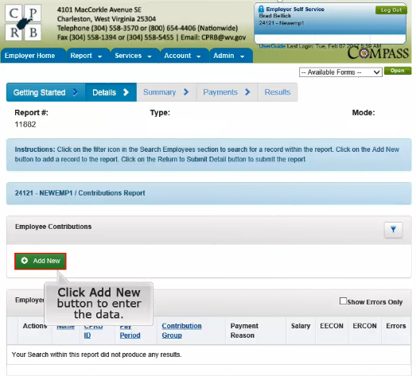
Add New Employee

Slide 24
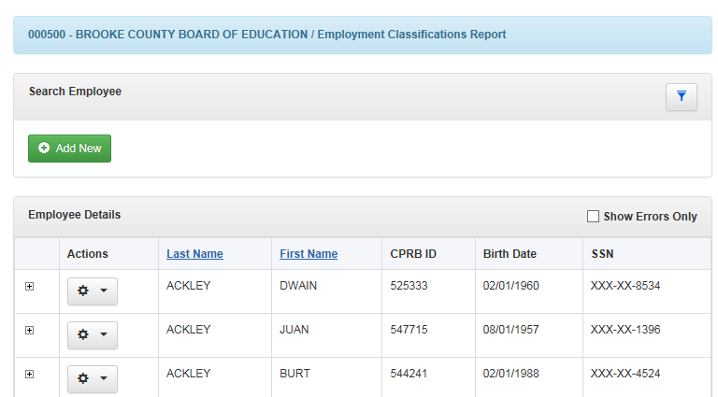
Opening a Report – Show Errors Unchecked

Slide 25
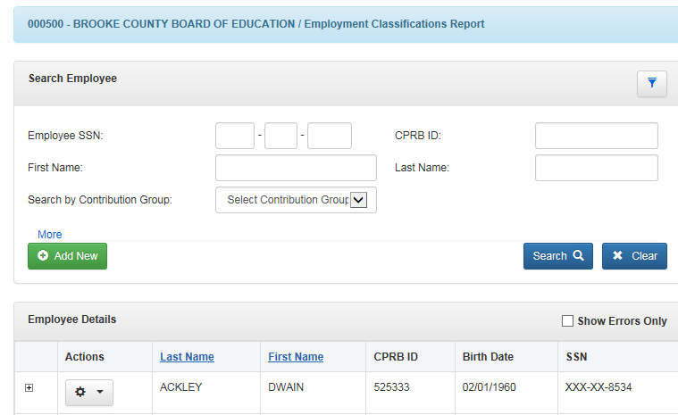
Search within a Report

Slide 26
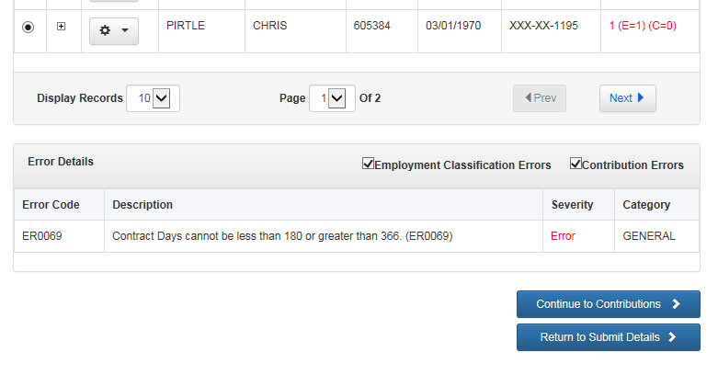
Viewing the Error on the Record

Slide 27
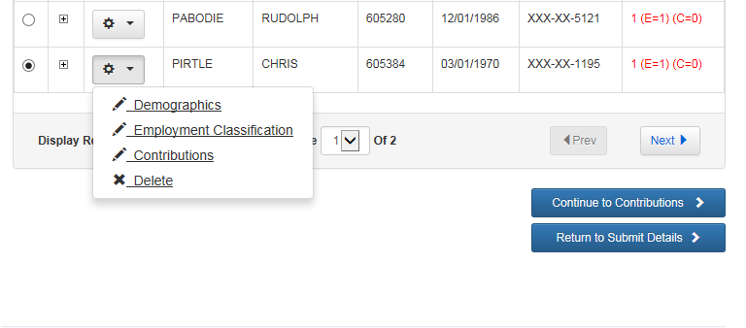
Opening an Employee Record within the Report

Slide 28
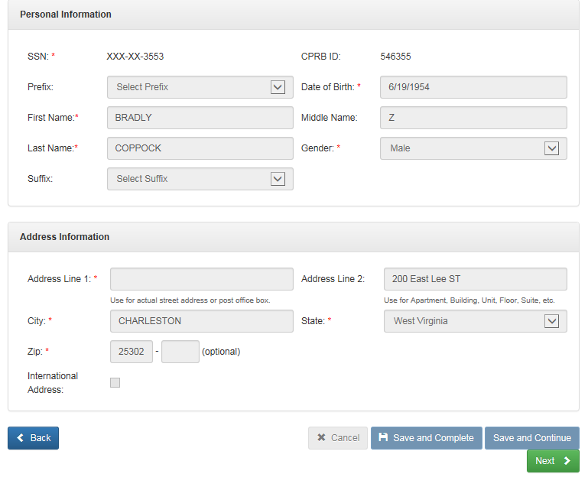
Demographics

Slide 29
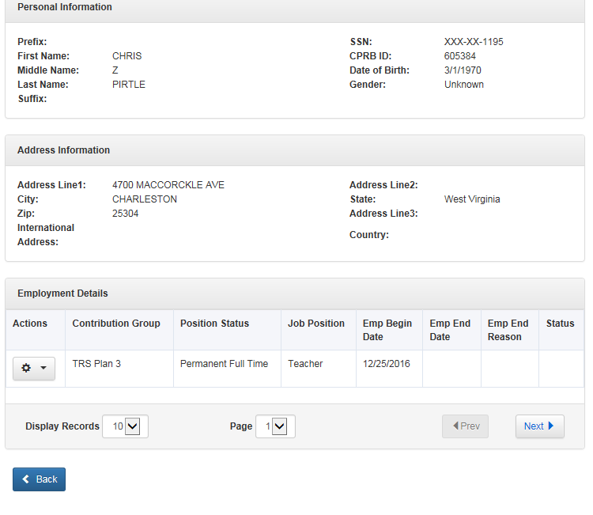
Employment Classifications

Slide 30
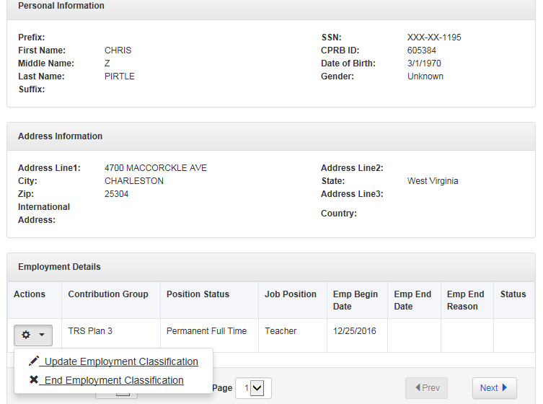
Employment Classifications – Updating or Ending

Slide 31
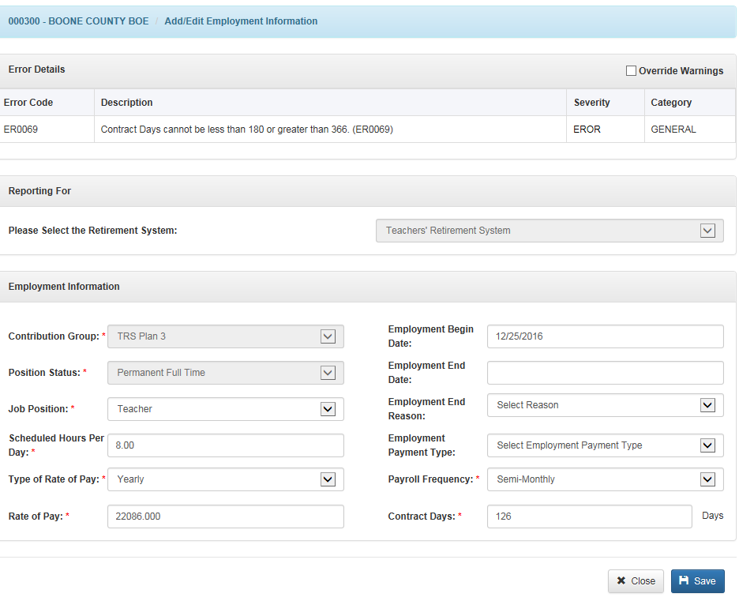
Employment Classifications – Updating

Slide 32
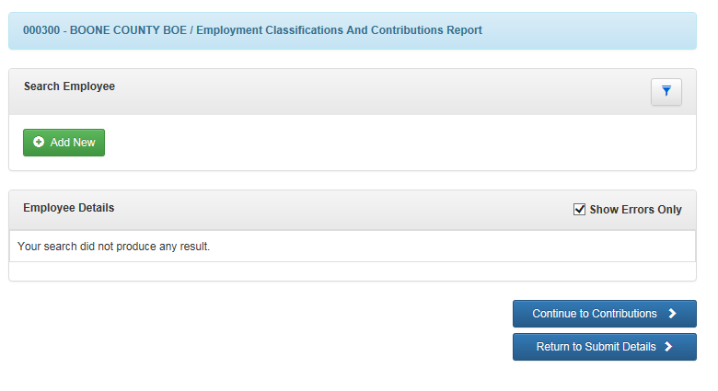
Adding an Employee who is not in the File

Slide 33
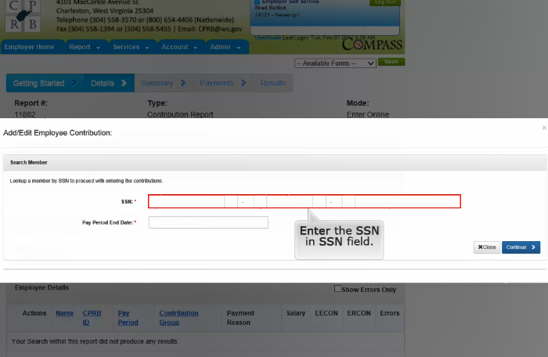
Adding Employee Not in File

Slide 34
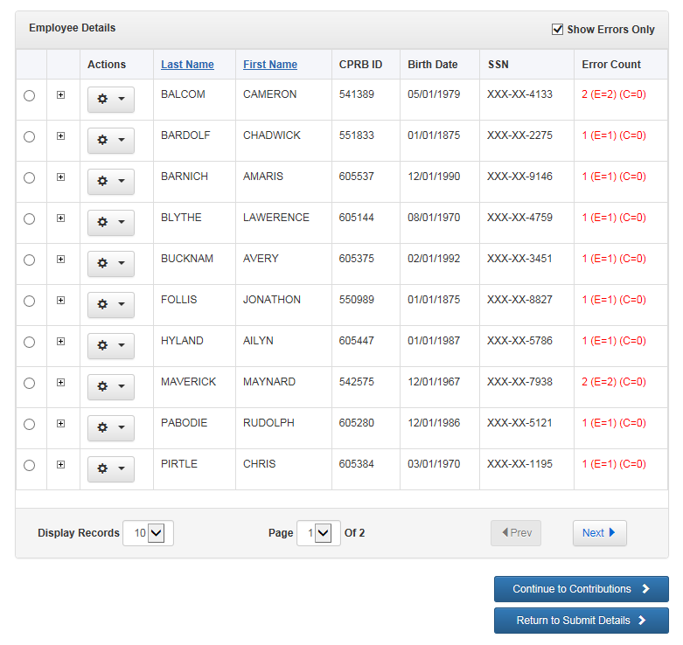
Opening a Report – Show Errors Checked

Slide 35
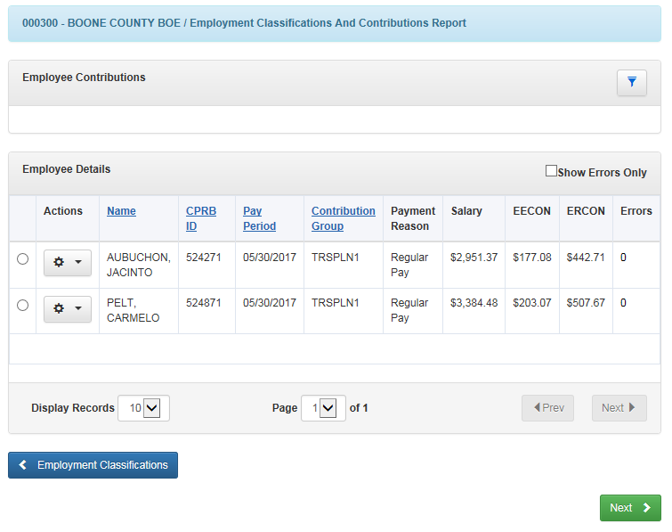
Continue to Contributions – Update or Delete

Slide 36
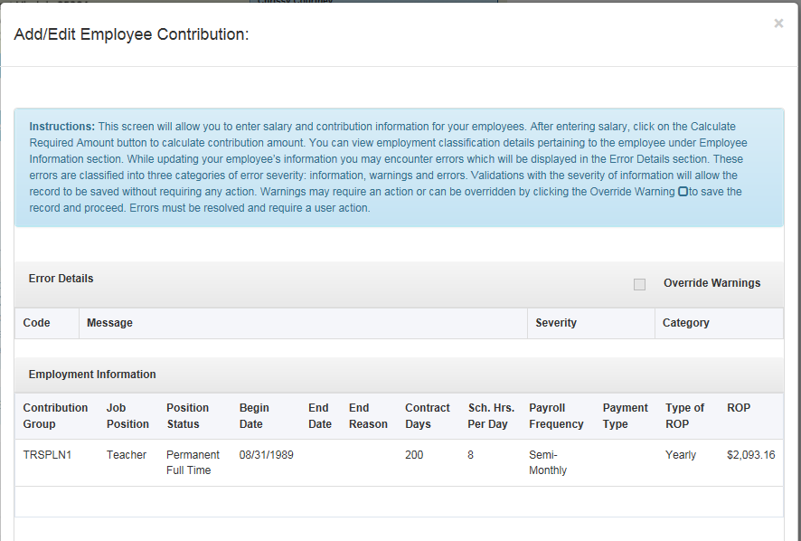
Contributions Updating – Employment Info

Slide 37
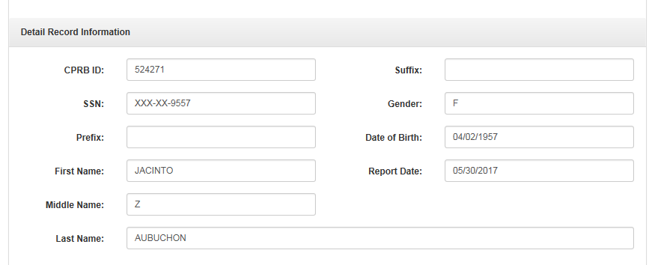
Contributions Updating – Detail Record Info

Slide 38
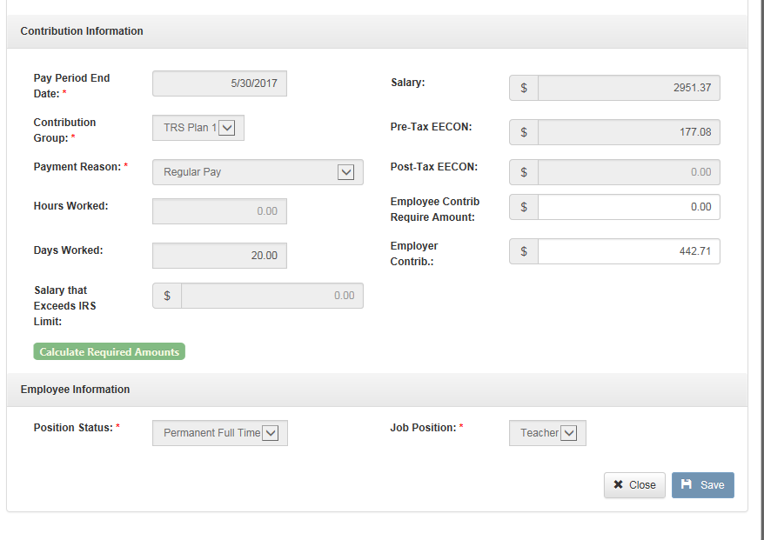
Contributions Updating – Contributions Info

Slide 39
Return to Submit Details

Slide 40
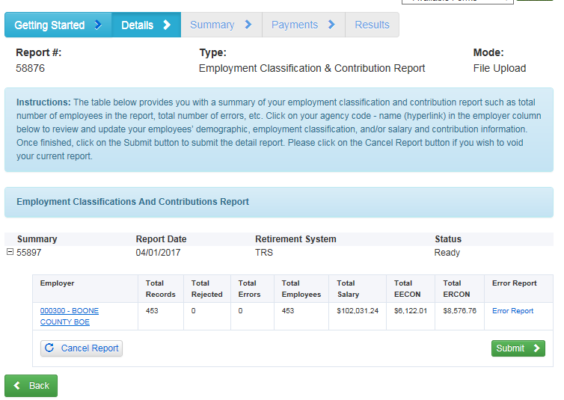
Return to Submit Details

Slide 41
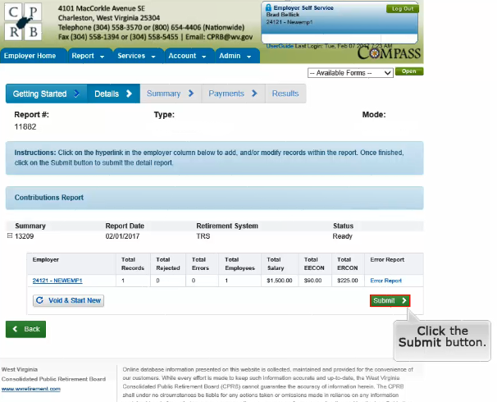
Submitting After Editing or Adding

Slide 42
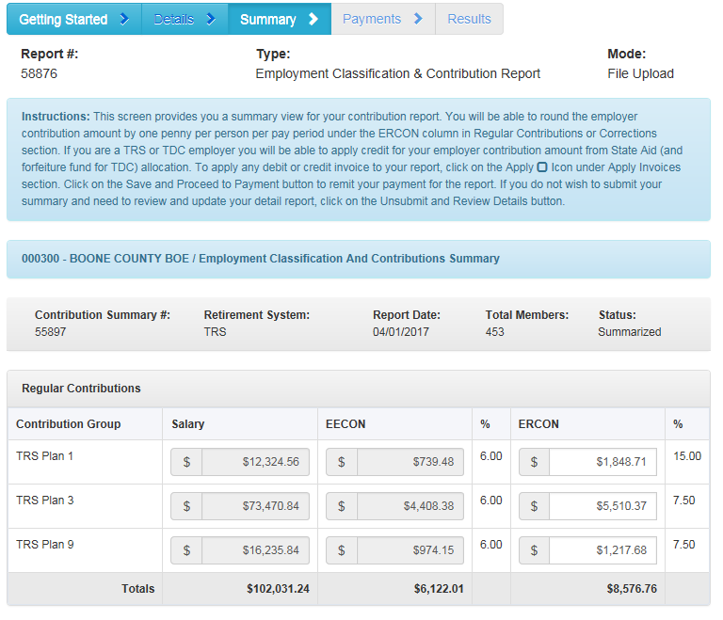
Summary After Submitting Details – Top

Slide 43
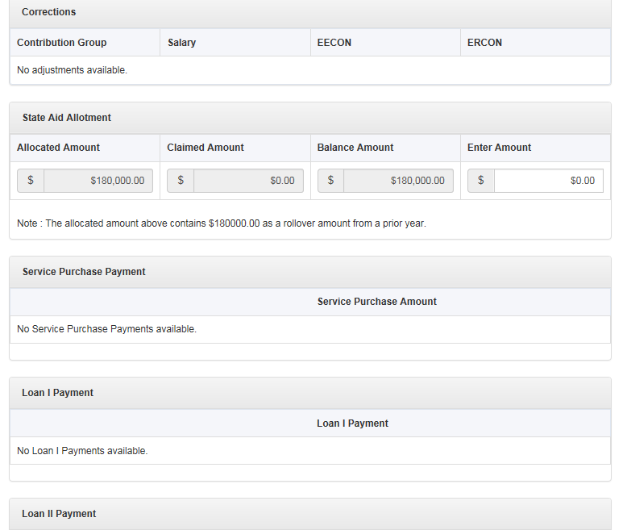
Summary After Submitting Details – Middle

Slide 44
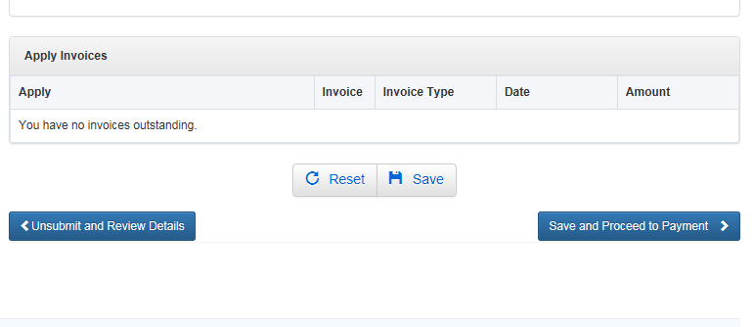
Summary After Submitting Details – Invoices

Slide 45
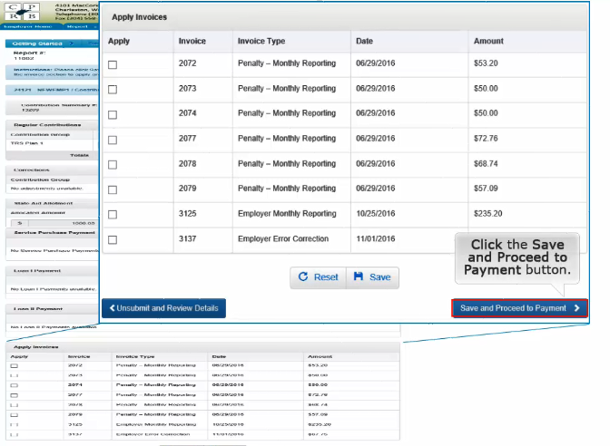
Applying Invoices

Slide 46
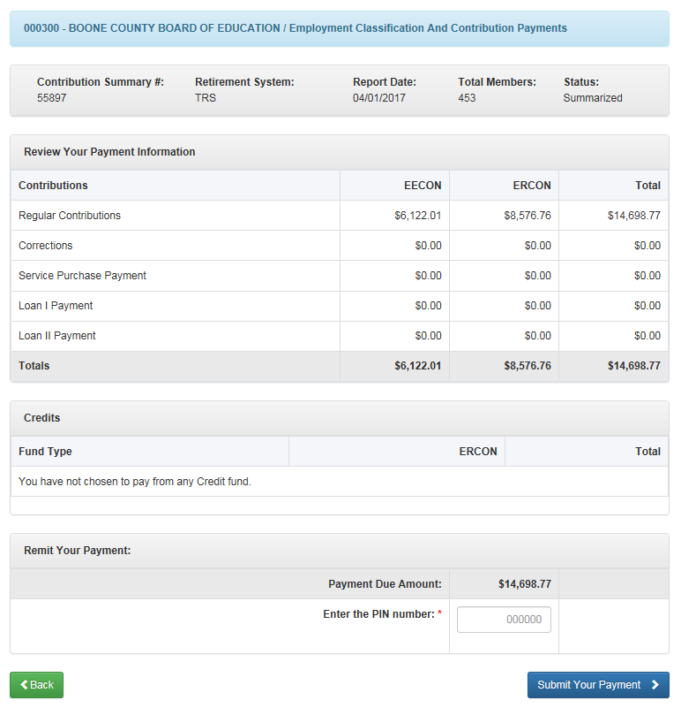
After Clicking Save and Proceed to Payment

Slide 47
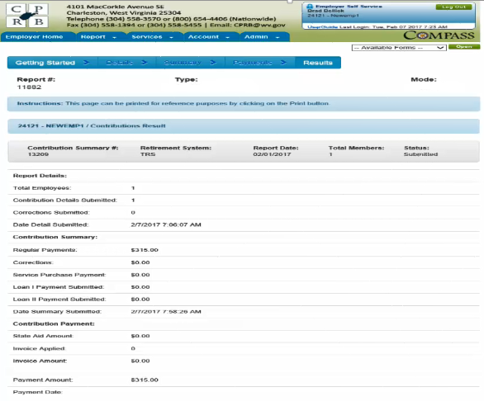
Summary

Slide 48

Employer Certifications
ESS allows employers to certify employee requests
for retirement, refund, disability, or service purchase. A certification email notification is sent to the employer informing them that an employee or former employee has initiated a request or a CPRB staff member initiated a request in COMPASS.
Notes:
Facilitator Notes:
ESS allows employers to certify employee requests through the self service module instead of filling out and signing paper forms. A certification will only appear when an employee or former employee has initiated a request with WVCPRB for a retirement, refund, disability or a service purchase.
On the Certification screen, only certifications in pending status display. Administrative and employer reporting users can use the Certification screen to approve or reject these certifications.

Slide 49
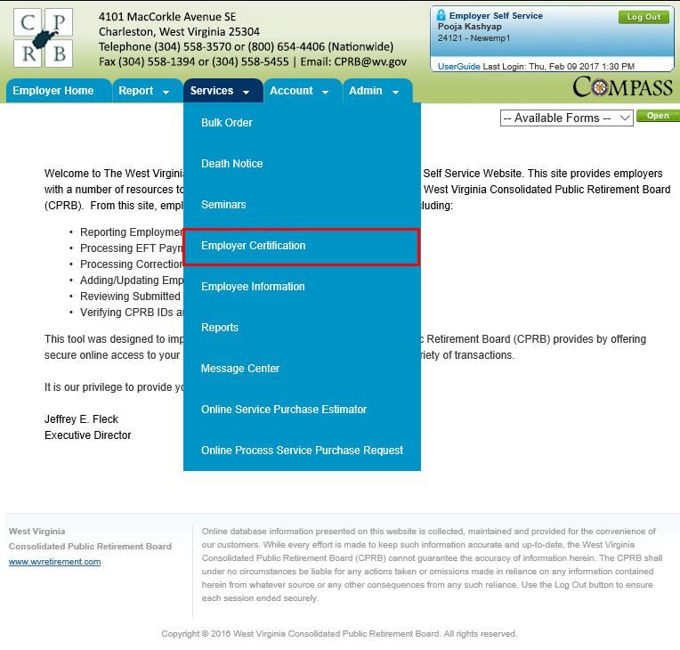
Employer Certifications
Certification options in ESS
Retirement & Refunds Certifications
Certify a Retirement
Certify a Refund
Notes:
Facilitator Notes:
Perform a walk through of the steps mentioned in the ‘ESS Registration’ section of the Employer Self Service user guide.
Ensure that all participants are able to access their mailbox to retrieve all the three emails related to their username, password, and PIN.
In case, they cannot in the classroom set up, do let them know to have this registration process completed prior to attending the session. This will also include them selecting their preferred security question.
Then, on this slide, you are only logging into ESS (assuming everybody has already registered for the session).
Additionally, while you are on the log in page (as shown here), you might quickly show them options related to Forgot username, and Forgot password, and how the security question comes in handy then.

Slide 50
Types of Certifications
An ESS user can view and approve the following certification types:
Retirement
Retirement request are initiated by a member (either via Member Self Service or submitting application to CPRB)
Employers certify the application and CPRB complete the retirement process for the member
Refunds
Refund request can be submitted by a member on Member Self Service or through COMPASS; if additional information or approval is required then the Employer will certify the Refund request through ESS
Service Purchase
Service purchase request are initiated by a member
Sent to the Employer for certification by CPRB as to process the members request
Disability
Disability request are initiated through Member Self Service or through COMPASS; if additional information or approval is required then the Employer will certify the Disability request through ESS
Notes:
Facilitator Notes:
Service Purchase requests are initiated by a service purchase counselor by providing comments and clicking on ‘Return to ESS’ button from COMPASS. These requests appear on ESS and require additional information from the employer to process the service purchase request. Once additional information has been added by the employer, the certification is submitted. Consequently the service purchase request status is updated to ‘Progress’ and workflow process service purchase resumes and is placed in the service purchase queue. Internal WVCPRB users next process the request using COMPASS’s Service Purchase module.
Retirement requests are initiated either by the member using Member Self Service or by the traditional retirement form. Request information will be created upon electronic submission of the retirement application via Member Self Service. If a paper form is received then an internal WVCPRB user will use retirement application form to create Request. On submission of Request. The application must be approved by the employer. Once the employer approves the application, the status of the Term Date (Employment End Date) Verification and Final Salary verification will be updated.
Refund and Disability requests are initiated through Member Profile. These requests appear on ESS and require additional detail from the employer. Once additional details have been added by the employer, the certification is submitted.

Slide 51
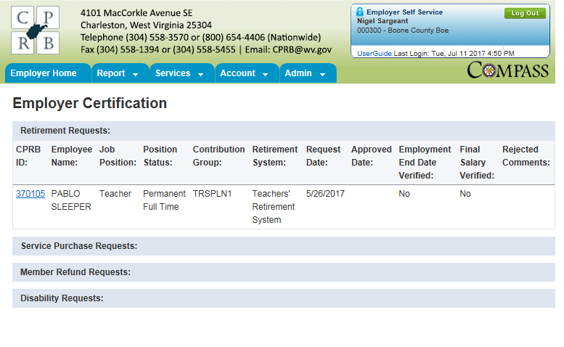
Certification Example – Retirement
Notes:
Facilitator Notes:
Service Purchase requests are initiated by a service purchase counselor by providing comments and clicking on ‘Return to ESS’ button from COMPASS. These requests appear on ESS and require additional information from the employer to process the service purchase request. Once additional information has been added by the employer, the certification is submitted. Consequently the service purchase request status is updated to ‘Progress’ and workflow process service purchase resumes and is placed in the service purchase queue. Internal WVCPRB users next process the request using COMPASS’s Service Purchase module.
Retirement requests are initiated either by the member using Member Self Service or by the traditional retirement form. Request information will be created upon electronic submission of the retirement application via Member Self Service. If a paper form is received then an internal WVCPRB user will use retirement application form to create Request. On submission of Request. The application must be approved by the employer. Once the employer approves the application, the status of the Term Date (Employment End Date) Verification and Final Salary verification will be updated.
Refund and Disability requests are initiated through Member Profile. These requests appear on ESS and require additional detail from the employer. Once additional details have been added by the employer, the certification is submitted.

Slide 52
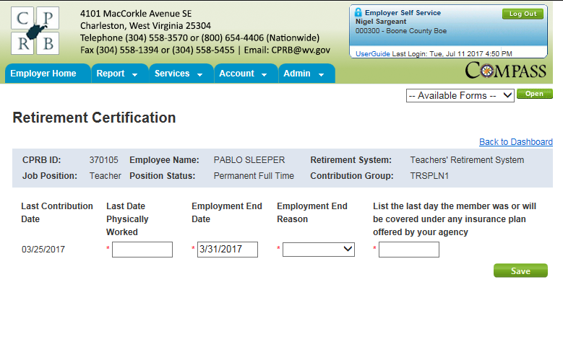
Certification Example – Retirement
Notes:
Facilitator Notes:
Service Purchase requests are initiated by a service purchase counselor by providing comments and clicking on ‘Return to ESS’ button from COMPASS. These requests appear on ESS and require additional information from the employer to process the service purchase request. Once additional information has been added by the employer, the certification is submitted. Consequently the service purchase request status is updated to ‘Progress’ and workflow process service purchase resumes and is placed in the service purchase queue. Internal WVCPRB users next process the request using COMPASS’s Service Purchase module.
Retirement requests are initiated either by the member using Member Self Service or by the traditional retirement form. Request information will be created upon electronic submission of the retirement application via Member Self Service. If a paper form is received then an internal WVCPRB user will use retirement application form to create Request. On submission of Request. The application must be approved by the employer. Once the employer approves the application, the status of the Term Date (Employment End Date) Verification and Final Salary verification will be updated.
Refund and Disability requests are initiated through Member Profile. These requests appear on ESS and require additional detail from the employer. Once additional details have been added by the employer, the certification is submitted.

Slide 53
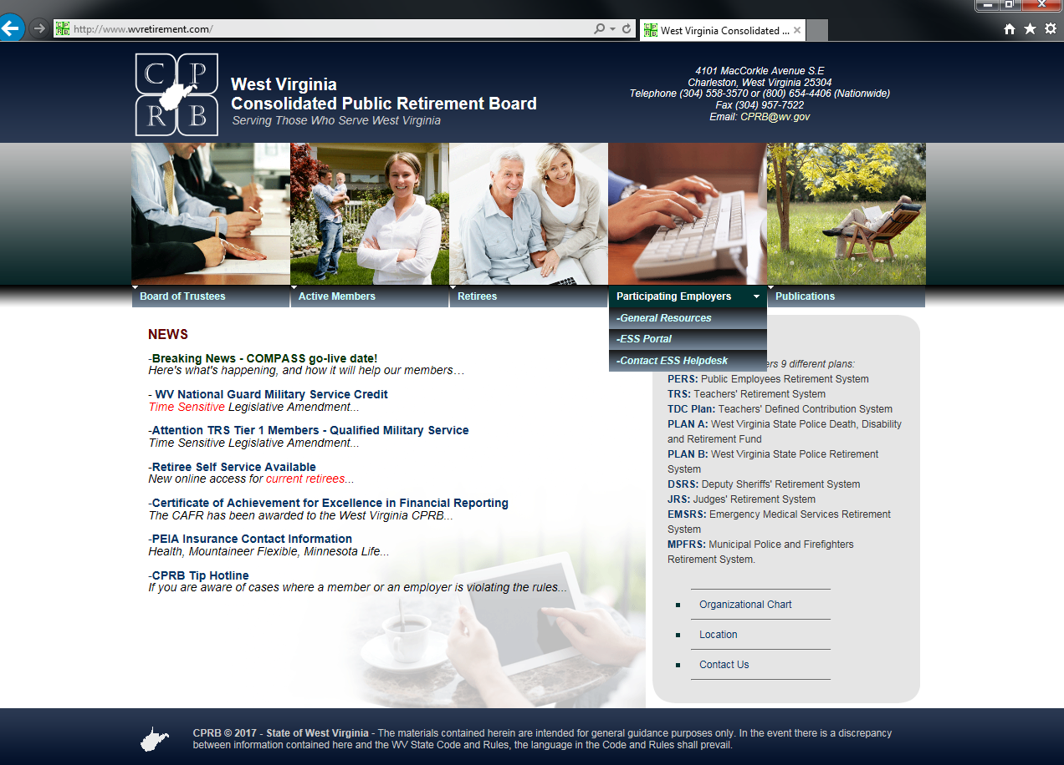
Resources on www.wvretirement.com
Participating Employers Tab

Slide 54
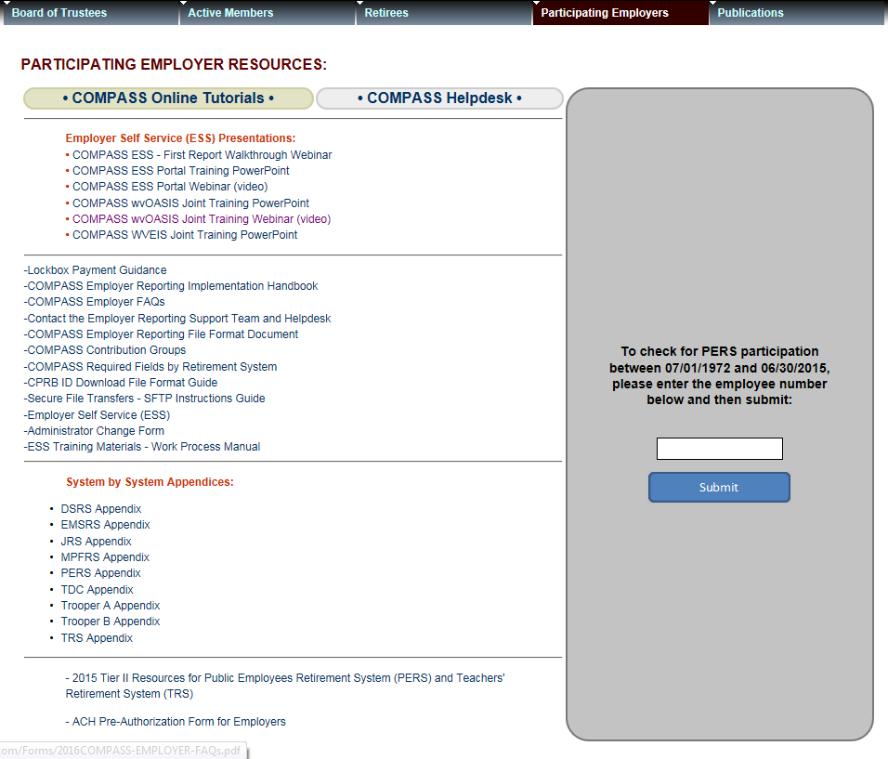
Resources on www.wvretirement.com
General Resources – COMPASS Online Tutorials

Slide 55
Questions?
Send questions via email to CPRBEmployerHelp@wv.gov
Phone: 304-558-1395 or 855-867-3797

